Slide 1

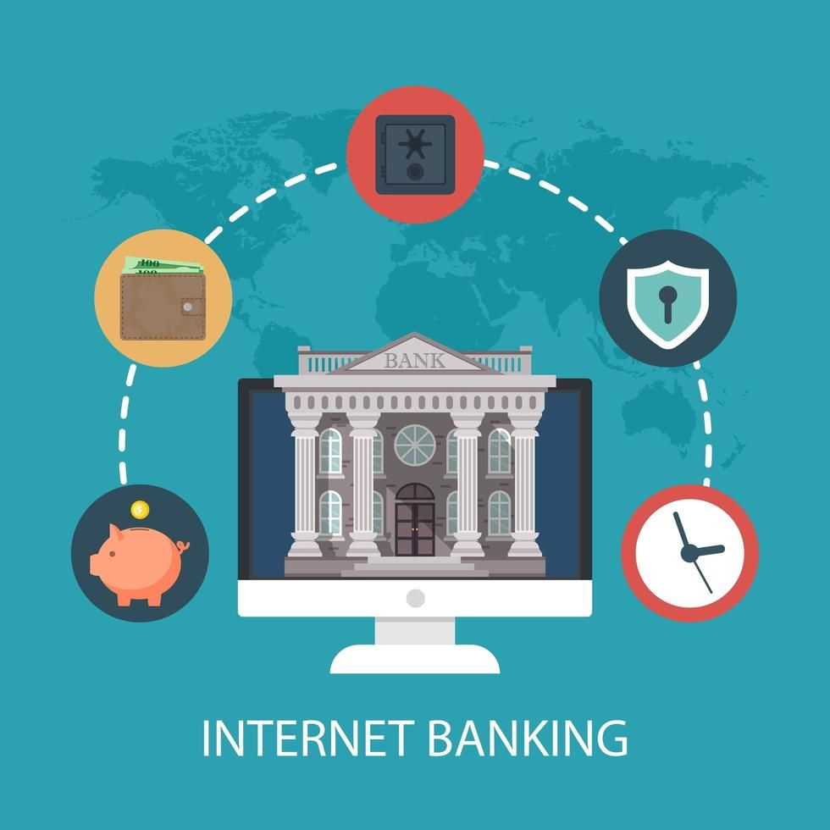
INTERNET BANKING APPLICATion & WEBSITE
Submitted by
BANDI JOHNY ESTHER
DHANUSHA M
JUBEDHA B
PUNITHAVATHI P

Slide 2


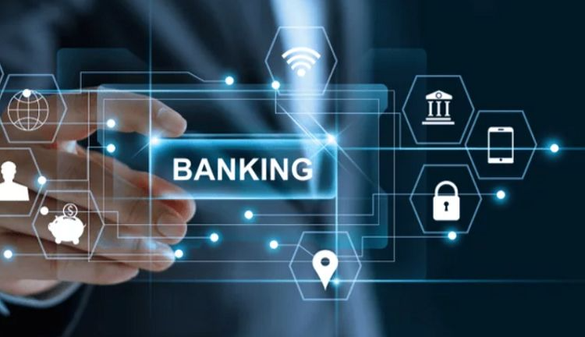
ABSTRACT
Introducing our new internet banking application, designed to make managing your finances easier and more convenient than ever before. With our user-friendly interface, you can quickly access all of your account information, transfer funds, pay bills, and manage your investments with just a few clicks. Our advanced security features, including encryption and two-factor authentication, ensure that your transactions are safe and secure. Say goodbye to long lines at the bank and hello to the flexibility of banking on your own schedule. Download our internet banking application today and take control of your finances like never before.. Security measures, such as encryption and two-factor authentication, may also be emphasized to assure users of the safety of their transactions.

Slide 3
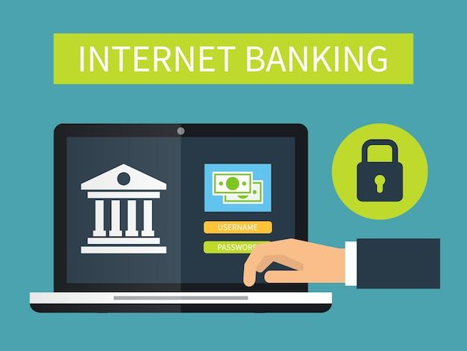
INTRODUCTON
Managing finances can be a tedious and time-consuming task, but with the advent of technology, banking has become more convenient than ever before. Internet banking has revolutionized the way we handle our finances, allowing us to access our accounts, make transactions, and manage our finances from the comfort of our own homes. With our internet banking application, you can experience the full range of banking services in the palm of your hand. No more waiting in long lines or trying to squeeze a bank visit into your busy schedule. Our application is designed to provide you with the flexibility and convenience you need to manage your finances efficiently. In this article, we will take a closer look at the benefits and features of our internet banking application and how it can help you take control of your finances.

Slide 4
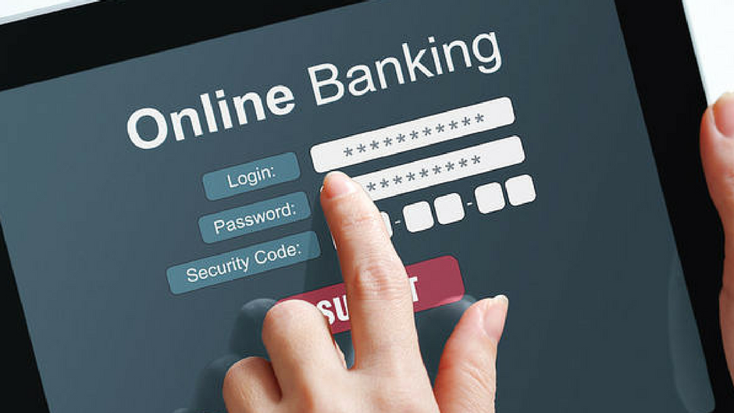
OVERVIEW
An Internet Banking Application is an online platform that enables customers to access and manage their banking transactions and accounts through the internet. An overview of such an application could include the following features and functionalities like
Account management
Funds Transfer
bill payments
Deposits &Withdrawals
Moblie banking
Customer services
Security
Personalization
Alerts & Notifications
Analytics& Reporting.

Slide 5
DRAWBACKS OF OLD BANKING SYSTEM
Time-consuming: The traditional banking system was a manual process that involved a lot of paperwork and manual verification processes, which made it a time-consuming process.
Limited access: The old banking system had limited access to banking services and products, which meant that not everyone could easily access financial services.
High fees: Traditional banks often charged high fees for their services, which could make it difficult for individuals with limited financial resources to access banking services.
Limited hours of operation: Traditional banks had limited hours of operation, which could be inconvenient for customers who needed to conduct banking transactions outside of regular business hours.
Security risks: The old banking system relied heavily on physical security measures, which could be vulnerable to theft, fraud, and other security risks.
Lack of innovation: The traditional banking system was slow to adopt new technologies and innovation, which meant that customers did not have access to the latest banking products and services.
Lack of transparency: The old banking system was often opaque, with customers not having clear visibility into the fees and charges associated with their accounts and transactions.

Slide 6
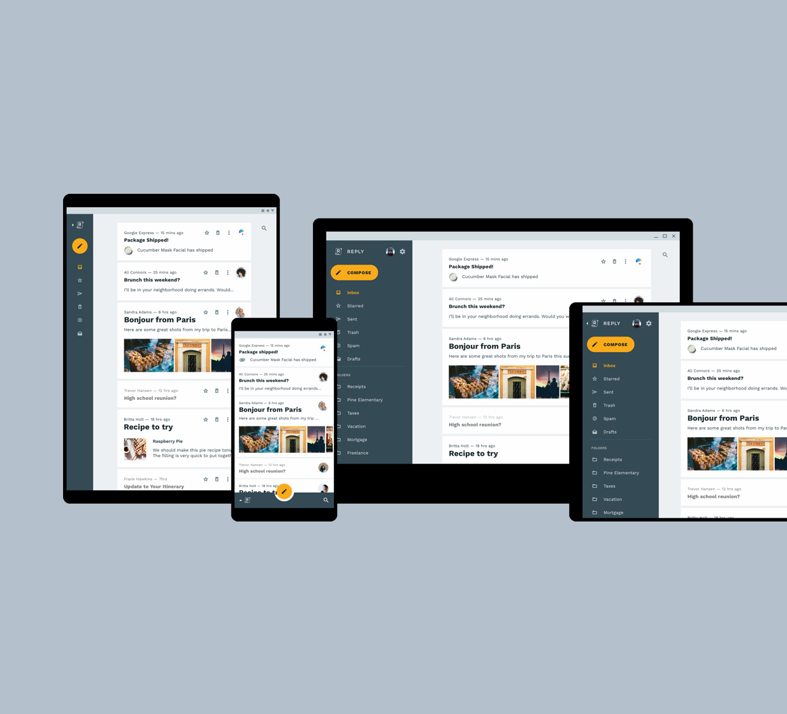
PLATFORM
In this Internet Banking system Supports both as a web - based Application & a moblie app for Android

Slide 7
OBJECTIVE
Account Management: Customers can view their account balance, transaction history, and other account details.
Funds Transfer: Customers can transfer money between their own accounts or to other accounts within the same bank or other banks.
Bill Payment: Customers can pay their bills such as utility bills, credit card bills, etc. through the application.
Deposits and Withdrawals: Customers can make deposits and withdrawals to their accounts.
Mobile Banking: The application should be accessible through mobile devices to enable customers to perform transactions on-the-go.

Slide 8
Customer Service: The application should provide access to customer service through chatbots or other means of communication.
Security: The application should have robust security features such as two-factor authentication, encryption, and fraud detection to ensure the safety of customers' transactions.
Personalization: The application should provide personalized offers and services based on customer's transaction history and behavior.
Alerts and Notifications: The application should send real-time alerts and notifications to customers on their account activities and transactions.
Analytics and Reporting: The application should provide comprehensive analytics and reporting on customer's transaction history, spending patterns, and other relevant insights.

Slide 9
GOALS
Convenience: Internet banking allows customers to access their account information and perform transactions from their computer or mobile device without having to physically visit a bank branch.
Speed: Online banking transactions can be processed much faster than traditional banking methods, allowing customers to save time and complete transactions quickly.
24/7 Access: With internet banking, customers can access their accounts and perform transactions 24/7, regardless of the time of day or location.
Cost Savings: Online banking can help reduce banking fees and transaction costs, as there is less need for physical bank branches and personnel.

Slide 10
scope
Account Management: Customers can view their account balance, transaction history, and statements.
Fund Transfers: Customers can transfer funds between accounts, pay bills, and make purchases online.
Loan Applications: Customers can apply for loans and credit cards online.
Investment Services: Customers can buy and sell stocks, bonds, and other investment products online.
Customer Support: Internet banking provides customer support through online chat, email, and phone support.

Slide 11

TECHNICAL PROCESS
OS: WINDOWS 8/9/10/11
Front End: HTML, CSS, Java Script
Back End: MySQL
For Android App: Java on Android Studio

Slide 12
INTERFACE REQUIRMENT
A GUI (Graphical User Interface) is a common user interface for internet banking systems. Here are some elements that can be included in a GUI for internet banking:
Login Screen: The login screen is the first screen that users encounter when accessing the internet banking system. It typically includes fields for users to enter their login credentials, such as username and password.
Dashboard: The dashboard is the main screen that users see after logging in. It provides an overview of their account balances, recent transactions, and other account-related information.
Navigation Menu: The navigation menu provides users with access to the different features and services available in the internet banking system. It can be presented as a list of links or icons that users can click on to access different sections of the system.

Slide 13
Account Information: The account information section displays detailed information about users' accounts, such as current balances, transaction history, and account statements.
Transaction Management: The transaction management section allows users to perform various transactions, such as transferring funds between accounts, paying bills, and setting up automatic payments.
Alerts and Notifications: The alerts and notifications section allows users to set up alerts for account activity, such as when a payment is due or when an account balance falls below a certain level
. Support and Help: The support and help section provides users with access to customer support and assistance. It can include links to FAQs, contact information for customer support, and a help section with articles and tutorials

Slide 14
PROCESS
The process of internet banking involves several steps, from the user logging into the system to performing transactions and logging out. Here is a general overview of the process.
Login: The user logs into the internet banking system using their username and password or other authentication methods, such as biometric authentication.
Dashboard: After logging in, the user is taken to the dashboard, which provides an overview of their account balances, recent transactions, and other account-related information.
Navigation: The user navigates through the system using the navigation menu to access different features and services, such as transaction management, bill payments, and account information.

Slide 15
Transaction Management: The user can perform various transactions, such as transferring funds between accounts, paying bills, and setting up automatic payments.
Alerts and Notifications: The user can set up alerts and notifications for account activity, such as when a payment is due or when an account balance falls below a certain level.
Support and Help: If the user needs assistance or support, they can access the support and help section, which provides links to FAQs, contact information for customer support, and a help section with articles and tutorials.
Logout: When the user is finished using the system, they log out to ensure the security of their account information.

Slide 16
User Authentication: The system should provide secure authentication methods to ensure that only authorized users have access to their account information and transactions.
Account Management: The system should allow users to view their account information, including balances, transactions, and account details. Users should also be able to manage their accounts, such as updating personal information, changing passwords, and adding or removing beneficiaries.
Fund Transfers: Users should be able to transfer funds between their own accounts or to other accounts within the bank or to other banks. The system should support different types of transfers, such as one-time or recurring transfers, and allow users to set limits on the amount of money they can transfer.
Bill Payments: Users should be able to pay their bills online, such as utility bills, credit card bills, and other payments. The system should allow users to schedule payments in advance and view payment histories.
Functional requirements for internet banking include:

Slide 17
Account Statements: The system should allow users to view and download their account statements for a specified period, such as the last 30 days or the last year.
Alerts and Notifications: The system should allow users to set up alerts and notifications for important account activities, such as low balance, incoming and outgoing transfers, and bill payments.
Customer Support: The system should provide customer support, such as online chat or email, to help users with their questions and issues.
Mobile Banking: The system should be accessible via mobile devices, such as smartphones and tablets, with the same functionality as the web-based system.

Slide 18
Non-functional requirements for internet Ranking includes:
Security: The system should provide high-level security to ensure that user data and transactions are safe from unauthorized access or cyber-attacks. It should comply with the latest security standards and regulations, such as PCI-DSS and ISO 27001.
Availability: The system should be available 24/7 to ensure that users can access their accounts and perform transactions at any time. The system should have a high uptime percentage and be able to handle a large number of users simultaneously.
Performance: The system should be able to handle a large volume of transactions and user requests without any delays or system crashes. It should have a fast response time for all operations, including fund transfers and bill payments.

Slide 19
Reliability: The system should be reliable and robust, with minimum downtime and system failures. It should be able to recover from any failures quickly and seamlessly.
Usability: The system should be user-friendly and easy to use, with a simple and intuitive interface. Users should be able to navigate the system easily and find the information they need quickly.
Accessibility: The system should be accessible to all users, including those with disabilities, by complying with accessibility standards, such as WCAG 2.0.
Scalability: The system should be scalable to accommodate an increasing number of users and transactions. It should be able to handle peak loads during high traffic periods without any performance degradation.

Slide 20
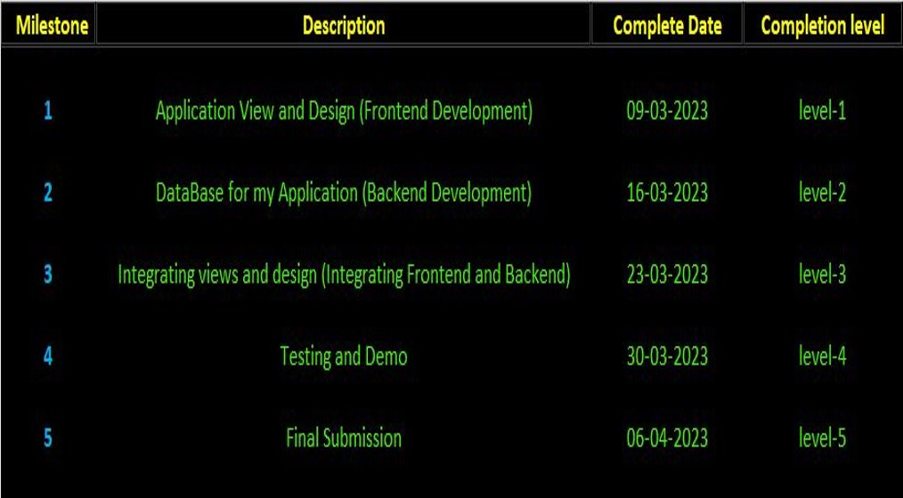
SCHEDULE

Slide 21
aDVANTAGES
Convenience
Cost-Effective
24/7 Access
Enhanced Security
Time-Saving
Efficient Record Keeping
Increased Transparency
Improved Customer Service

Slide 22
Convenience : Internet banking provides customers with the convenience of banking from anywhere and at any time, without having to visit a physical branch. Customers can perform various transactions such as fund transfers, bill payments, and account management tasks from their home or office.
Cost-Effective: Internet banking is cost-effective for banks as it reduces the need for physical branches, staff, and infrastructure. This allows banks to offer better rates, lower fees, and other incentives to customers.
24/7 Access: Internet banking is available 24/7, which means customers can access their accounts and perform transactions at any time of the day, even outside of traditional banking hours.
Enhanced Security: Internet banking provides a secure way of accessing and managing bank accounts. Banks use advanced security measures, such as encryption, two-factor authentication, and transaction monitoring to protect customers' information and prevent fraud.

Slide 23
Time-Saving: Internet banking saves time for customers as they can perform transactions quickly and easily without having to wait in queues or fill out physical forms.
Efficient Record Keeping: Internet banking provides customers with easy access to their transaction history, account statements, and other financial records. This helps customers to track their expenses, plan their finances, and file their taxes.
Increased Transparency: Internet banking provides customers with transparency about their accounts, transactions, and fees. Customers can view their account balances and transaction details in real-time, and banks provide detailed information about fees and charges.
Improved Customer Service: Internet banking allows banks to offer faster and more efficient customer service, as customers can access their accounts and resolve issues online without having to visit a physical branch

Slide 24
DISADVANTAGES
Security Risks
Technology Issues
Lack of Personal Interaction
Limited Cash Transactions
Limited Services
Technical Competence

Slide 25
Disadvantages for intertnet banking,
Security Risks: Internet banking carries some security risks, as cybercriminals can use various methods, such as phishing and malware, to steal customers' personal and financial information. While banks use advanced security measures to protect their customers, users also need to take measures to protect themselves, such as using strong passwords and avoiding public Wi-Fi networks.
Technology Issues: Internet banking requires a stable internet connection, and technical issues can occur, such as website downtime, slow loading times, or software glitches. These issues can result in inconvenience or frustration for customers.
Lack of Personal Interaction: Internet banking eliminates the face-to-face interaction that traditional banking offers. Some customers may prefer to visit a physical branch and interact with bank staff to ask questions, discuss financial plans, or seek advice.

Slide 26
Limited Cash Transactions: Internet banking limits the ability to perform cash transactions, such as making deposits or withdrawals. Customers may have to visit a physical branch to complete such transactions.
Limited Services: Internet banking may not offer the full range of services that physical branches offer. Some services, such as opening a new account, may require a physical visit to the branch.
Technical Competence: Internet banking requires users to have some technical competence to access and use the system. Some users may find it difficult to navigate the online platform or use certain features, which can lead to frustration.

Slide 27

🔗
LINK For GitHub Repositorie -
https://github.com/Punithavathi12/Internet-Banking-System.git

Slide 28
THANK YOU

